Slide 1
Day 6, JAVASCRIPT

Slide 2
Agenda
JavaScript Introduction
JavaScript Where To
JavaScript Output
JavaScript Statements
JavaScript Syntax
JavaScript Comments
JavaScript variables
JavaScript Let
JavaScript Const
JavaScript Operators
JavaScript Data Types
JavaScript Functions

Slide 3
Intoduction
JavaScript is the programming language of the Web.
JavaScript accepts both double and single quotes
It is also known as the scripting language for webpages.
JavaScript Can Change HTML Content
One of many JavaScript HTML methods is getElementById().
The example below "finds" an HTML element (with id="demo"), and changes the element content (innerHTML) to "Hello JavaScript“
Example:
..\Day 6 Javascript
javascript.html

Slide 4
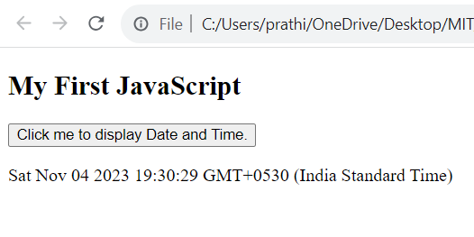
Example:
<!DOCTYPE html>
<html>
<body>
<h2>My First JavaScript</h2>
<button type="button"
onclick="document.getElementById('demo').innerHTML = Date()">
Click me to display Date and Time.</button>
<p id="demo"></p>
</body>
</html>

Slide 5
JavaScript Where To
The <script> Tag
In HTML, JavaScript code is inserted between <script> and </script> tags.
Syntax:
<script>
// JavaScript Code
</script>
How to Link JavaScript File in HTML ?
JavaScript can be added to HTML file in two ways:
Internal JS: We can add JavaScript directly to our HTML file by writing the code inside the <script> tag. The <script> tag can either be placed inside the <head> or the <body> tag according to the requirement.

Slide 6
External JS: We can write JavaScript code in another files having an extension.js and then link this file inside the <head> tag of the HTML file in which we want to add this code.
JavaScript Functions and Events
A JavaScript function is a block of JavaScript code, that can be executed when "called" for.
For example, a function can be called when an event occurs, like when the user clicks a button.
JavaScript in <head> or <body>
You can place any number of scripts in an HTML document.
Scripts can be placed in the <body>, or in the <head> section of an HTML page, or in both

Slide 7
JavaScript function is placed in the <head> section of an HTML page.
JavaScript function is placed in the <body> section of an HTML page.
The function is invoked (called) when a button is clicked.
Example:
script.html
External JavaScript
Scripts can also be placed in external files
JavaScript files have the file extension .js.
External scripts cannot contain <script> tags.
Example:
external.html

Slide 8
JS Output
JavaScript can "display" data in different ways:
Writing into an HTML element, using innerHTML.
Writing into the HTML output using document.write().
Writing into an alert box, using window.alert().
Writing into the browser console, using console.log().
Using innerHTML
To access an HTML element, JavaScript can use the document.getElementById(id) method.
The id attribute defines the HTML element. The inner HTML property defines the HTML content.
Example:
inner.html

Slide 9
Using document.write()
For testing purposes, it is convenient to use document.write()
The document.write() method should only be used for testing.
Example:
write.html
Using window.alert()
You can use an alert box to display data.
JavaScript Print
JavaScript does not have any print object or print methods.
You cannot access output devices from JavaScript.
The only exception is that you can call the window.print() method in the browser to print the content of the current window.
print.html

Slide 10
JS Statements
JavaScript statements are composed of: Values, Operators, Expressions, Keywords, and Comments.
This statement tells the browser to write "Hello Dolly." inside an HTML element with id="demo“
statement.html
Semicolons ;
Semicolons separate JavaScript statements.
Add a semicolon at the end of each executable statement.
semicolon.html

Slide 11
JS Code Blocks
JavaScript statements can be grouped together in code blocks, inside curly brackets {...}.
The purpose of code blocks is to define statements to be executed together.
codeblocks.html
JavaScript Keywords
JavaScript statements often start with a keyword to identify the JavaScript action to be performed.
JavaScript keywords are reserved words. Reserved words cannot be used as names for variables.

Slide 12
Keyword Description
var Declares a variable
let Declares a block variable
Const Declares a block constant
if Marks a block of statements to be executed on a condition
Switch Marks a block of statements to be executed in different cases
for Marks a block of statements to be executed in a loop
function Declares a function
Return Exits a function
try Implements error handling to a block of statements

Slide 13
JS Syntax
JavaScript syntax is the set of rules, how JavaScript programs are constructed
JavaScript Values
The JavaScript syntax defines two types of values:
Fixed values
Variable values
Fixed values are called Literals.
Variable values are called Variables
JavaScript Literals
The two most important syntax rules for fixed values are:
1. Numbers are written with or without decimals
2. Strings are text, written within double or single quotes

Slide 14
JS Syntax
JavaScript syntax is the set of rules, how JavaScript programs are constructed
JavaScript Values
The JavaScript syntax defines two types of values:
Fixed values
Variable values
Fixed values are called Literals.
Variable values are called Variables
JavaScript Literals
The two most important syntax rules for fixed values are:
1. Numbers are written with or without decimals
2. Strings are text, written within double or single quotes
Example:
JSliterals.html

Slide 15
Javascript Variables
In a programming language, variables are used to store data values.
JavaScript uses the keywords var, let and const to declare variables.
An equal sign is used to assign values to variables.
In this example, x is defined as a variable. Then, x is assigned (given) the value 6
JSvariables.html
JavaScript Keywords
JavaScript keywords are used to identify actions to be performed.
The let keyword tells the browser to create variables
The var keyword also tells the browser to create variables.
keywords.html

Slide 16
Javascript Comments
Not all JavaScript statements are "executed".
Code after double slashes // or between /* and */ is treated as a comment.
Comments are ignored, and will not be executed.
comments.html
JavaScript Identifiers / Names
Identifiers are JavaScript names.
Identifiers are used to name variables and keywords, and functions.
The rules for legal names are the same in most programming languages.

Slide 17
A JavaScript name must begin with:
A letter (A-Z or a-z)
A dollar sign ($)
Or an underscore (_)
Note
Numbers are not allowed as the first character in names.
JavaScript is Case Sensitive
All JavaScript identifiers are case sensitive.
JavaScript does not interpret LET or Let as the keyword let.
Example
JScasesensitive.html

Slide 18
JS Comments
JavaScript comments can be used to explain JavaScript code, and to make it more readable.
JavaScript comments can also be used to prevent execution, when testing alternative code.
Single Line Comments
Single line comments start with //.
Any text between // and the end of the line will be ignored by JavaScript (will not be executed).
Example:
singleline.html

Slide 19
Multi-line comment
Multi-line comments start with /* and end with */.
Any text between /* and */ will be ignored by JavaScript.
multiline.html
Using comments to prevent execution
Using comments to prevent execution of code is suitable for code testing.
Adding // in front of a code line changes the code lines from an executable line to a comment.
preventexecution.html

Slide 20
JS Variables
Variables are Containers for Storing Data.
JavaScript Variables can be declared in 4 ways:
Automatically
Using var
Using let
Using const
When to Use var, let, or const?
1. Always declare variables
2. Always use const if the value should not be changed
3. Always use const if the type should not be changed (Arrays and Objects)
4. Only use let if you can't use const
5. Only use var if you MUST support old browsers.

Slide 21
Example:
automaticvariable.html
Declaring a JavaScript Variable
Creating a variable in JavaScript is called "declaring" a variable.
You declare a JavaScript variable with the var or the let keyword:
var carName; or let carName;
After the declaration, the variable has no value (technically it is undefined).
To assign a value to the variable, use the equal sign:
carName = "Volvo";
You can also assign a value to the variable when you declare it:
let carName = "Volvo"; * declarevariable.html

Slide 22
One Statement, Many Variables
You can declare many variables in one statement.
Start the statement with let and separate the variables by comma.
A declaration can span multiple lines.
Example:
* multiplevariable.html
Value = undefined
A variable declared without a value will have the value undefined.
The variable carName will have the value undefined after the execution of this statement.
Example:
* undefinevariable.html

Slide 23
JS Let
Variables defined with let cannot be Redeclared
Variables defined with let must be Declared before use
Variables defined with let have Block Scope
Cannot be Redeclared
Variables defined with let can not be redeclared.
You can not accidentally redeclare a variable declared with let.
With let you can not do this:
let x = "John Doe";
let x = 0;
With Var you can:
Var x=“Ammu”;
Var x=0;

Slide 24
Block Scope
Two important new JavaScript keywords: let and const.
These two keywords provide Block Scope in JavaScript.
Variables declared inside a { } block cannot be accessed from outside the block:
Example
{
let x = 2;
}
// x can NOT be used here

Slide 25
Variables declared with the var keyword can NOT have block scope.
Variables declared inside a { } block can be accessed from outside the block.
Example
{
var x = 2;
}
// x CAN be used here
Redeclaring a variable using the let keyword can solve this problem.
Redeclaring a variable inside a block will not redeclare the variable outside the block
variableLet.html

Slide 26
JS Const
Variables defined with const cannot be Redeclared
Variables defined with const cannot be Reassigned
Variables defined with const have Block Scope
Cannot be Reassigned
A const variable cannot be reassigned
const.html
When to use JavaScript const?
Always declare a variable with const when you know that the value should not be changed.
Use const when you declare:
*A new Array *A new Function
*A new Object *A new RegEx

Slide 27
Constant Objects & Arrays
The keyword const is a little misleading.
It does not define a constant value. It defines a constant reference to a value.
Because of this you can NOT:
Reassign a constant value
Reassign a constant array
Reassign a constant object
But you CAN:
Change the elements of constant array
Change the properties of constant object

Slide 28
Constant Arrays
You can change the elements of a constant array
constArray.html
// You can create a constant array: const cars = ["Saab", "Volvo", "BMW"]; // You can change an element: cars[0] = "Toyota"; // You can add an element: cars.push("Audi");
But you can NOT reassign the array
notreassignArray.html
const cars = ["Saab", "Volvo", "BMW"]; cars = ["Toyota", "Volvo", "Audi"]; // ERROR

Slide 29
JS Operators
JavaScript operators operate the operands, Operators are used to performing specific mathematical and logical computations on operands
There are different types of JavaScript operators:
Arithmetic Operators
Assignment Operators
Comparison Operators
String Operators
Logical Operators
Bitwise Operators
Ternary Operators
Type Operators

Slide 30
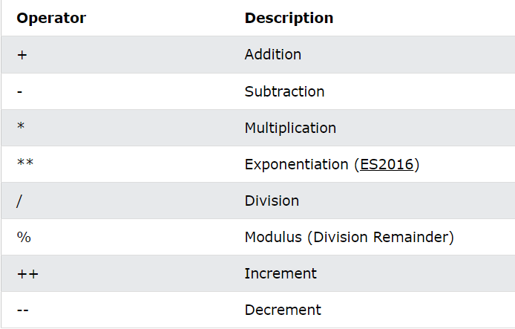
Arithmetic Operators
Arithmetic operators perform arithmetic on numbers (literals or variables).
Example
arithmeticoperator.html

Slide 31
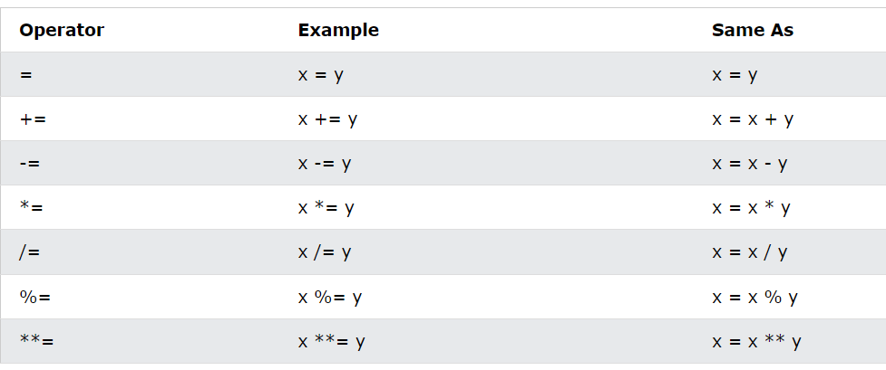
Assignment Operators
Assignment operators assign values to JavaScript variables.
Example:
assignmentoperator.html

Slide 32
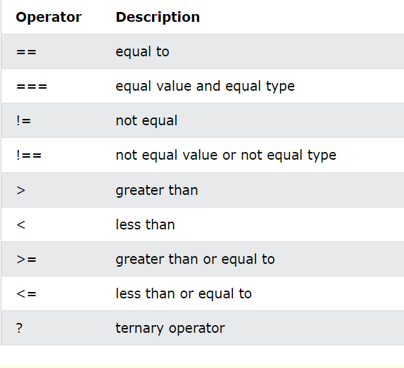
Comparision Operators
Comparison operators are used in logical statements to determine equality or difference between variables or values.
Example
comparisionoperator.html

Slide 33
String Comparision
All the comparison operators above can also be used on strings
Note that strings are compared alphabetically
stringComparision.html
Javascript Addition
The += assignment operator can also be used to add (concatenate) strings.
Adding Strings and Numbers
Adding two numbers, will return the sum, but adding a number and a string will return a string.
stringNumber.html

Slide 34
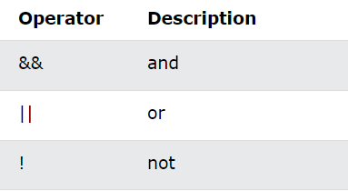
Logical Operator
Logical operators are used to determine the logic between variables or values.
Example:
Logicaloperator.html

Slide 35
Logical Operator
Logical operators are used to determine the logic between variables or values.
Example:
Logicaloperator.html

Slide 36
JS DataTypes
In programming, data types is an important concept.
To be able to operate on variables, it is important to know something about the type.
JavaScript has 8 Datatypes
1. String
2. Number
3. Bigint
4. Boolean
5. Undefined
6. Null
7. Symbol
8. Object
The Object Datatype
The object data type can contain:
1. An object
2. An array
3. A date

Slide 37
JS types are Dynamic
JavaScript has dynamic types. This means that the same variable can be used to hold different data types.
dynamicdatatye.html
JavaScript Strings
A string (or a text string) is a series of characters.
Strings are written with quotes. You can use single or double quotes.
stringDT.html
JavaScript Numbers
All JavaScript numbers are stored as decimal numbers (floating point).
Numbers can be written with, or without decimals
NumberDT.html

Slide 38
JavaScript BigInt
All JavaScript numbers are stored in a a 64-bit floating-point format.
JavaScript BigInt is a new datatype (ES2020) that can be used to store integer values that are too big to be represented by a normal JavaScript Number.
BigintDT.html
JavaScript Booleans
Booleans can only have two values: true or false.
Booleans are often used in conditional testing
BooleanDT.html

Slide 39
JavaScript Arrays
JavaScript arrays are written with square brackets.
Array items are separated by commas.
Array indexes are zero-based, which means the first item is [0], second is [1], and so on.
ArrayDT.html
JavaScript Objects
JavaScript objects are written with curly braces {}.
Object properties are written as name:value pairs, separated by commas.
ObjectDT.html

Slide 40
JS Functions
A JavaScript function is a block of code designed to perform a particular task.
A JavaScript function is executed when "something" invokes it (calls it).
JavaScript Function Syntax
A JavaScript function is defined with the function keyword, followed by a name, followed by parentheses ().
function name(parameter1, parameter2, parameter3) {
// code to be executed
}
Function names can contain letters, digits, underscores, and dollar signs

Slide 41
Function Invocation
The code inside the function will execute when "something" invokes (calls) the function:
When an event occurs (when a user clicks a button)
When it is invoked (called) from JavaScript code
Automatically (self invoked)
Function Return
When JavaScript reaches a return statement, the function will stop executing.
If the function was invoked from a statement, JavaScript will "return" to execute the code after the invoking statement.
Functions often compute a return value. The return value is "returned" back to the "caller“ * functionreturn.html

Slide 42
The() operator
The () operator invokes (calls) the function
Accessing a function without () returns the function and not the function result
Function.html
Functions Used as Variable Values
Functions can be used the same way as you use variables, in all types of formulas, assignments, and calculations.
Instead of using a variable to store the return value of a function
You can use the function directly, as a variable value
Functionvariable.html

Slide 43
Local variable
Variables declared within a JavaScript function, become LOCAL to the function.
Local variables can only be accessed from within the function
Local variables are created when a function starts, and deleted when the function is completed.
Localvariable.html

